Slide 1
Twitter-Based Activity Patterns:
A Case Study From Post-Circuit Breaker Singapore
Group 5
Lim Zhu An
Phang Yong Xin
Sherie Loh Wei
Xu Yuting

Slide 2
Contents
1.0 Abstract
2.0 Introduction
3.0 Methodology 3.1 Data Collection 3.2 Spatiotemporal Analysis and Linear Regression Analysis 3.3 Random Forest Model
4.0 Result and Analysis 4.1 Twitter Users in Singapore 4.2 Spatiotemporal Analysis 4.3 Ordinary Least Squares Regression Analysis 4.4 Random Forest Classification and Modelling
5.0 Discussion 5.1 Spatiotemporal Tweet Patterns and Contribution from Service Amenities 5.2 Suitability of Twitter Data for Geospatial Research on Singapore 5.3 Other Limitations
6.0 Conclusion
7.0 References

Slide 3
Abstract
Since 19 July 2020, Singapore entered Phase 2 of re-opening after one and half month’s “Circuit Breaker” measures to curb the spread of COVID 19. Although most businesses and public places have resumed operation at a reduced capacity, individuals are strongly advised to practice social distancing and avoid crowds. Both implicit and explicit measures to prevent overcrowding may have changed how people visit places in Singapore. This study uses geotagged Twitter data from September to October 2020 to examine the spatial and temporal patterns of residents’ locations in Singapore and explore if service amenities remain “attractive” to residents. While distinct temporal patterns of tweets generally aligned with an office-hour behaviour, spatial analysis revealed no statistically significant clusters. The regression analysis also showed that distance to service amenities do not provide strong explanations for tweeting patterns. This study uses a Random Forest Supervised Machine Learning Model to train and predict total tweet counts at different locations across the study area. The top five explanatory variables are Parks, Parks and malls public links, Taxi stands, Residential areas, and Shopping malls. These variables have the strongest influence in driving the model prediction of total tweet counts per location.

Slide 4
2.0 Introduction

Slide 5
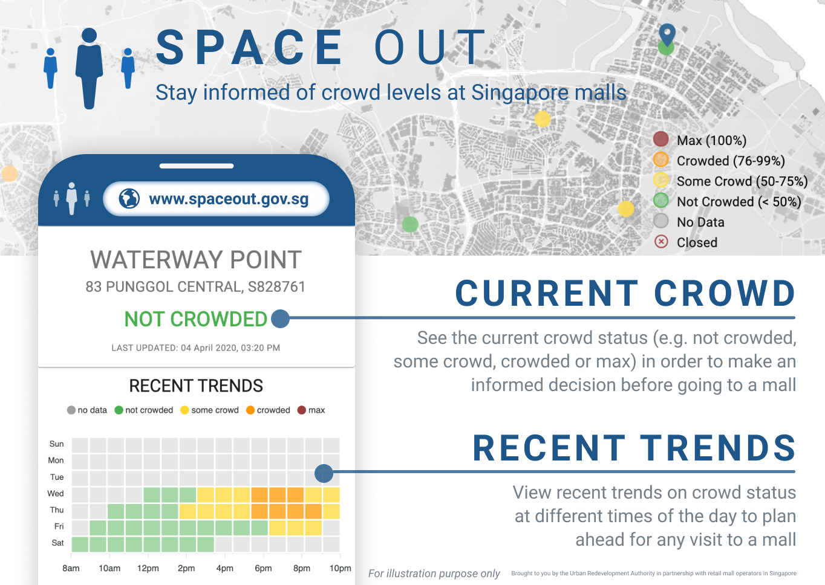
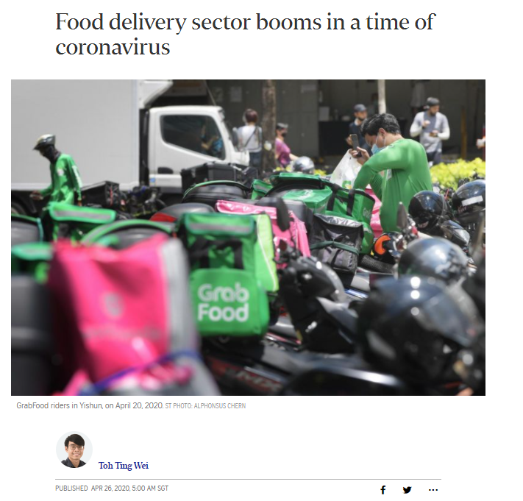
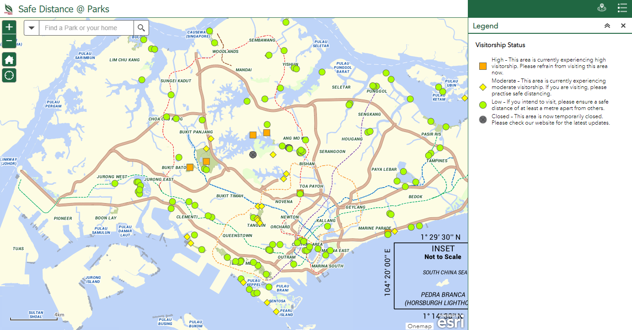
2.0 Introduction
Singapore entered Phase 2 re-opening since 19 July 2020
All residents advised to practice safe distancing, avoid crowded areas
Businesses/agencies/institutions rolled out measures to facilitate safe usage of public spaces
Fewer people visit F&B
→ Potential changes in place-visiting behaviours and activity patterns!
https://www.straitstimes.com/singapore/transport/sector-booms-in-a-time-of-coronavirus
ura.gov.sg
safedist.nparks.gov.sg
Notes:
As of 19 July, Singapore has entered Phase 2 of reopening after one and a half month of Circuit Breaker measures. These measures were implemented to restrict the usage of public spaces. With phase 2, small group gatherings are allowed and most businesses reopened, while high-risk settings such as bars, pubs and karaoke services remain closed. Residents were advised to practice safe distancing and avoid crowded areas. Government agencies rolled out apps such as URA’s Space Out and NParks’ Safe Distancing @ Parks to inform residents on the crowd level in respective public places, allowing people to make informed decisions on when and where to go for services. More explicit movement control measures, such as zoning and no-visitor rules, have also been implemented by some organisations such as NUS. At the same time, more Singaporeans have opted to have services delivered to them, instead of them visiting the amenities. This unique context post-CB generates interest to understand what activity patterns are like currently, and whether services and amenities still attract people to visit them.

Slide 6
Using Twitter Data to Study Activity Patterns
Location-based social media data increasingly used for urban science and GIS research:
Rich attribute information (temporal, spatial, semantic), easy to obtain
Study public sentiments, individual and aggregated activity-space, activity trajectory, location profiling and association
COVID-related research: movement volume vs infection rates (Kabir and Madria, 2020)
Twitter-based research in Singapore
Only a handful; mostly explored semantic information (public sentiment during elections)
Rarely used geospatial aspect of Tweets
→ a valuable dataset that is not fully explored in the context of Singapore for geospatial research questions
Notes:
We have chosen to use twitter data to study these activity patterns. Location-based social media data which are contributed by individual users voluntarily, offers a wealth of information, including temporal, spatial and semantic attributes, and has been used in a growing body of literature, especially in the fields of urban science and GIS. Studying these data can helps us understand individual activity-space and spatiotemporal public space visiting patterns and crowd behaviours during a major event. There have also been COVID related research done in the US, using tweets to analyse public sentiments and mobility patterns.
In Singapore, most studies using Twitter data focused on analysing semantic information, and very few used Tweets to understand urban places. There is also a gap in knowledge on how the unique context of post-Circuit Breaker re-opening has changed place-visiting patterns, and whether Twitter data is suitable for studying Singapore’s urban spaces.

Slide 7




Research Questions
What are activity patterns like in a post-CB Singapore?
Are service amenities still important in attracting activities?
Are Twitter data suitable for geospatial research in Singapore?
Notes:
And therefore, In this study, we want to use Twitter data to explore the spatial-temporal patterns of activities in post-CB Singapore. Based on the place-visiting patterns established, we then modeled and predicted visitors at places during non-office recreational hours, and examined how such patterns relate to service amenities. the findings will also enable a discussion on the suitability of Twitter data to understand geospatial questions in the context of Singapore.

Slide 8
3.0 Methodology

Slide 9
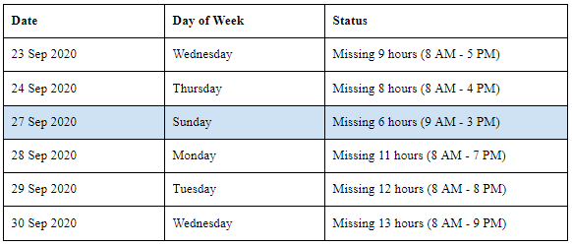
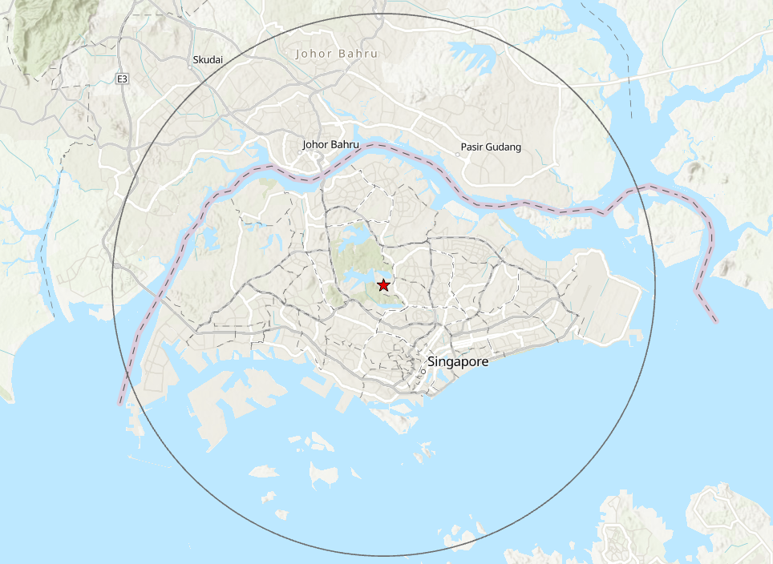
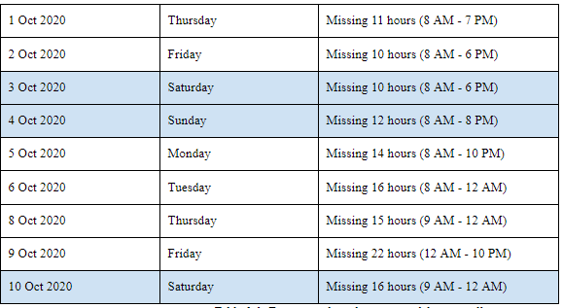
3.1 Data Collection
Tweets
Twitter public API to search for all tweets posted from 18 Sep to 10 Oct 2020
Spatial extent: 25 km radius from Central Catchment - covered most of Singapore main island
Note: unsuccessful data collection for some time periods(unstable network connection and search rate limit imposed by Twitter)
Notes:
We used the Twitter standard API to search for all tweets posted from 18 Sep to 10 Oct. A spatial extent of 25 km radius from the central catchment was defined for tweet collection via the API, as this area effectively covers most of the mainland Singapore.
However, due to an unstable network connection and search rate limit imposed by Twitter, there were time periods when tweet collection was unsuccessful. This is shown on the table on the right

Slide 10
3.1 Data Collection
Twitter API returns each tweet object with relevant attributes, including user details, full text of tweets, timestamp and tweet location (full list of attributes in Appendix 8.1). Varied levels of spatial precision were observed with the tweets collected (Table 3.2) as a result of user account setting. According to Twitter product policy, Twitter users who chose to enable precise location on their account will have all their tweets geotagged automatically to specific coordinates, while users who chose not to enable precise location may still optionally tag individual tweets to a location by keying in a place name. Tweets with exact X/Y coordinates were digitised into point features directly, while tweets with a specific landmark as place name are geocoded using OneMap search API (https://docs.onemap.sg/#search) by providing the Place_Name attribute as keywords to obtain the coordinates. Because some place names in the tweets are erroneous or not recognised in the OneMap API, only 306 tweets with specific landmark place names were successfully geocoded. Tweets with spatial information at the scale of a neighbourhood and above were recognised to give a poor indication of the user device location, and were not used in spatial analysis.
Spatial Precision of Collected Tweets
Tweets returned by Twitter API have varied levels of spatial precision based on the users’ settings
Tweets with:
Exact X/Y coordinates: digitised into point features directly
Specific landmark as place name: geocoded using OneMap search API
Spatial information at neighbourhood scale or above: not used
Type of Spatial Attributes (in decreasing order of precision) | Percentage of Tweets
With exact coordinates (X/Y) | 0.25%
With place name (a specific landmark), but without X/Y coordinates | 0.31%
With place name (a neighbourhood/town), but without X/Y coordinates | 0.01%
With place name (a region), but without X/Y coordinates | 2.43%
With place name (a city), but without X/Y coordinates | 0.03%
With place name (a state/province), but without X/Y coordinates | 0.00%
With place name (a country), but without X/Y coordinates | 0.05%
No explicit spatial information | 96.91%
Notes:
Twitter API returns each tweet object with relevant attributes, including user details, the tweet, timestamp and tweet location. However the spatial precision of the tweet location varies in accordance to the user’s account settings. Twitter users who chose to enable precise location on their account will have all their tweets geotagged automatically to specific coordinates, while users who chose not to enable precise location may still optionally tag individual tweets to a location by keying in a place name. The table on the right shows the different level of spatial precision of the tweets collected.
Of these tweets, those with exact XY coordinates were digitised into point features directly, while tweets with a specific landmark as place name are geocoded using OneMap search API However, some place names in the tweets are erroneous or not recognised in the OneMap API, only 306 tweets with specific landmark place names were successfully geocoded. Tweets with spatial information at the scale of a neighbourhood and above would give a poor indication of the user device location, and were not used in spatial analysis.

Slide 11
3.1 Data Collection
Points of Interest (POI) and other Geospatial Data
12 types of service amenity POIs selected as explanatory variables
Geospatial locations of POIs were collected from official government sources.
Data | Source
Hawker Centres Residential with 1st Storey Commercial Community Clubs Parks Park Connector Network Dual Use Scheme (DUS) Sports Facilities SCDP Park Mall Master Plan 2019 | data.gov.sg
Shopping Malls | List of shopping malls in Singapore from Wikipedia (https://en.wikipedia.org/wiki/List_of_shopping_malls_in_Singapore) and geocoded using OneMap search API
MRT Stations Bus Stops Taxi Stands | mytransport.sg
Medical Facilities | KML file extracted from Google Maps
Notes:
These are the point of interests that we have selected as explanatory variables and the locations of these points of interests were mainly collected from official government sources.

Slide 12
3.2 Spatiotemporal Analysis and Linear Regression Analysis
Exploratory Data Analysis
To understand spatiotemporal activity patterns (framework adapted from Rao et al. (2012))
Ordinary Least Square (OLS) regression analysis
Estimate relationship between aggregated tweet counts against the distance to the nearest service amenity POIs
 | Temporal Analysis | Spatial Analysis | Dynamic Spatiotemporal Analysis | Static Spatiotemporal Analysis
Temporal Attribute | Independent | Fixed | Independent | Fixed
Spatial Attribute | Fixed | Independent | Dependent | Dependent
Thematic Attribute | Dependent | Dependent | Fixed | Fixed
Examples of questions for this study | In the same location, how do activity patterns vary with time? | In the same time period, how do activity patterns vary in places? | How do spatial patterns of activities vary with time? | How do spatial patterns vary in different locations at a fixed point of time?
Notes:
We analysed the digitised tweet point features for their spatial and temporal patterns by adopting this spatiotemporal analysis framework.
We then performed OLS regression to estimate the relationship between the aggregated tweet counts against the distance to the nearest service amenity POIs to explain the spatial patterns of tweets.

Slide 13
3.3 Random Forest Model
Objective: model activity patterns in off-work recreational hours
Tool: ArcGIS Forest-Based Classification and Regression
An adaptation from Leo Breiman’s Random Forest Algorithm, which is a supervised machine learning model.
To train a model based on the number of tweets at different locations in Singapore, given a set of explanatory variables
Notes:
We chose to use the random forest regression model on ArcGIS to model the number of tweets at different locations across the study area. With the input of service amenity POIs as point/polygon feature layers, the tool is able to generate distances from each training feature to be used for the training of the regression model. Presence of land uses and distance to amenities were conceptualised as potential explanatory variables to model and predict spatial distribution of people in the area.

Slide 14
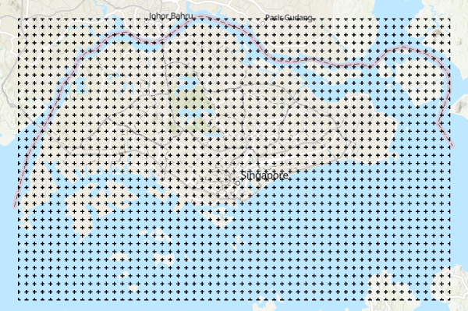
3.3 Random Forest Model
Model Training Input layer :
Fishnet Grid cells points (1kmx1km)
Attribute variables - land use mix type (Categorical) and total tweet counts
Notes:
To create the point feature layer with attributes that describe the area, we split singapore into square fishnet grids of 1 km by 1 km. This spatial resolution was chosen based on computation power and time required to run the model. It also potentially increases the number of land use types per fishnet grid. The presence of land use in each grid was denoted with categorical attributes.

Slide 15
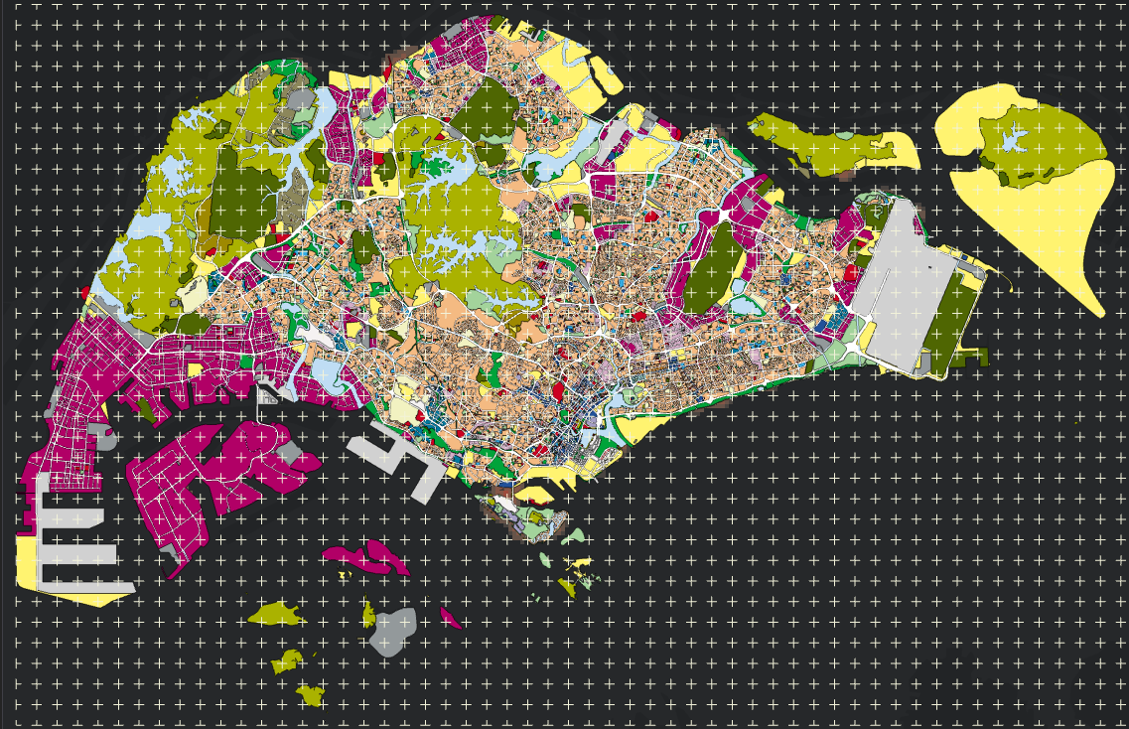
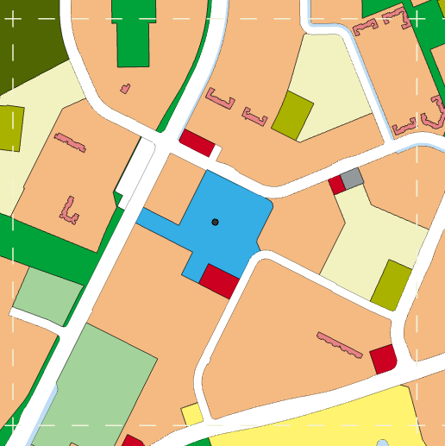
3.3 Random Forest Model
Extracting Land use mix type per fishnet grid cell in categorical fields (i.e. 1 or 0)
Notes:
On the left shows 1 fishnet grid, and we extract the various land use here into categorical fields

Slide 16
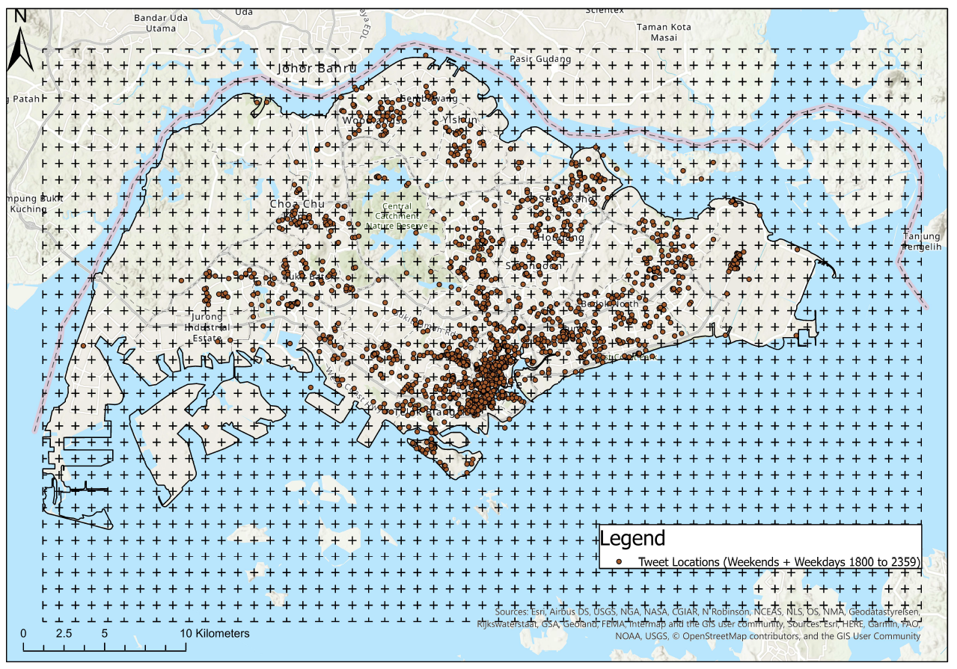
3.3 Random Forest Model
Extracting Total Tweet counts per fishnet grid cell via spatial join
Tweets are only from weekends and weekdays 1800 to 2359 hrs (non-working hours)
A total of 3982 tweets
Notes:
Tweets posted on Weekends as well as Weekdays from 6pm to midnight were aggregated in each grid to produce a total count to represent spatial distribution of people during off-work recreational hours. A total of 3982 tweets were used in this model input. The land use and tweet count attributes were then joined to the fishnet centroid point features for model input.

Slide 17
3.3 Random Forest Model
Explanatory distance variables:
Shopping Malls - Point layer
Residential with 1st storey commercial (e.g. HDB shop houses) - Point layer
Parks - Point layer
SDCP park and mall public link - Polygon layer
Hawker Centres - Point layer
Park Connectors - Polygon layer
School Facilities - Point layer
Community Clubs - Point layer
Bus stop - Point layer
Mrt Stations - Point layer
Taxi stands - Point layer
Medical Facilities - Point layer
Notes:
Besides land uses, service amenity POIs were used as explanatory training distance features. The tool generates the distance between each training feature point and all the distance variable features. these are then used as continuous numerical inputs for the training of the model.

Slide 18
3.3 Random Forest Model
Model Parameters
Number of Trees | 500
Leaf Size | 5
Tree Depth | 11-26
Mean Tree Depth Range | 16
% of Training Available per Tree | 100
Number of Randomly Sampled Variables | 8
% of Training Data Excluded for Validation | 10
Notes:
We initially trained with 100% of the training data to determine the key explanatory variables that were driving the result of the model. After a few iterations, we settled with 500 trees while the other parameters of the model were left on the default settings. After a stable model is trained, we then used 10% of the training data to validate the accuracy of the model.

Slide 19
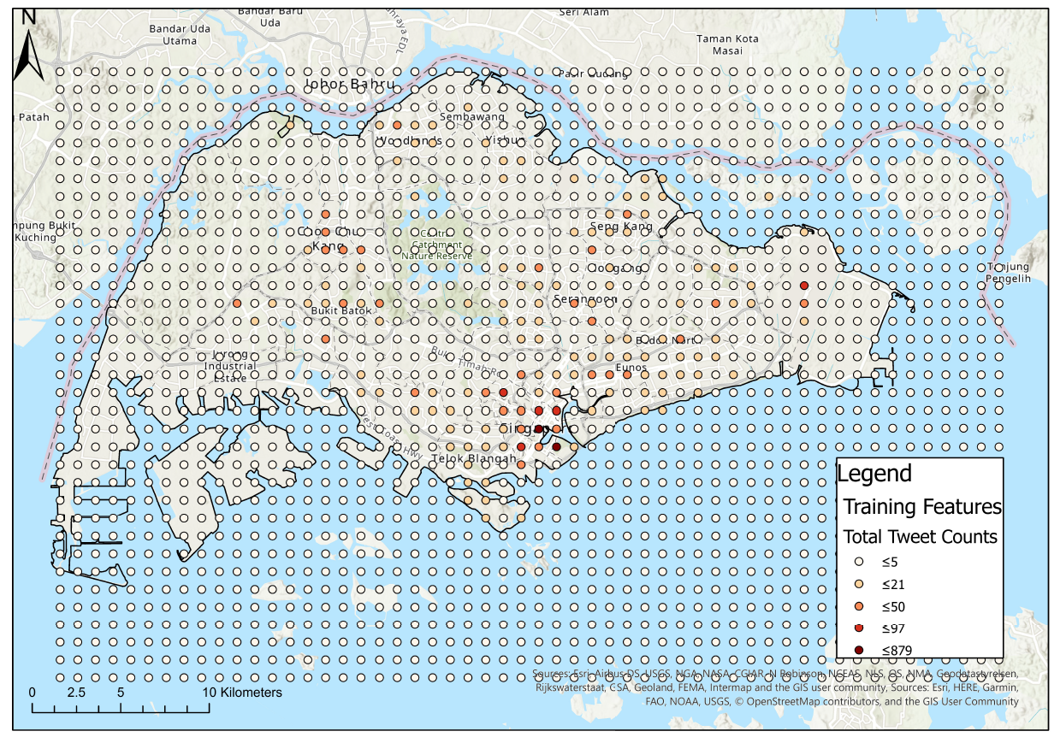
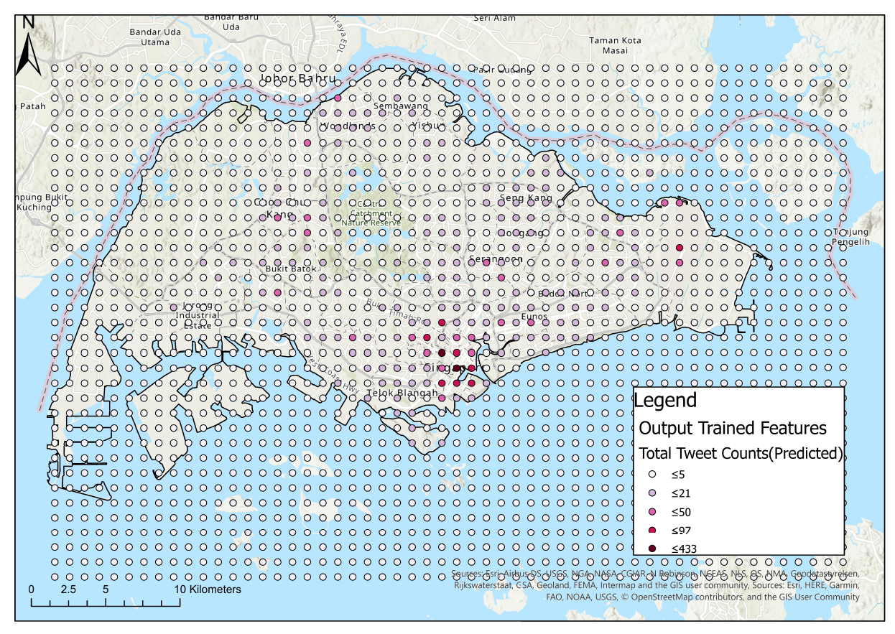
3.3 Random Forest Model
Model Training Input
Model Trained Features Prediction
Notes:
This shows the model training input and the trained model features prediction

Slide 20
4.0 Result and Analysis

Slide 21
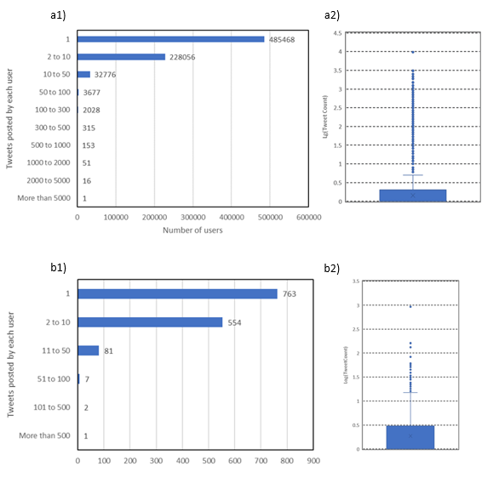
4.1 Twitter Users in the Study Area
All tweets collected
Tweet counts by each user varied remarkably
A large number of users posted only 1 tweet in the entire period of data collection
A small group of users contribute to a large number of tweets
Pattern is consistent with similar social media studies
Geotagged tweets in Singapore
Figure 4.1. a) Distribution of all tweets (total tweets = 2,776,651, total user = 748,533, mean tweets/user = 3.71, median tweets/user = 1, sd = 25.46), b) Distribution of geotagged tweets in Singapore (total tweet count = 5,754, total user = 1,396, mean tweets/user = 4.12, median tweets/user = 1, sd = 25.87)
Notes:
We had about 750,000 users contributing to about 2.8million tweets over the data collection period of 18 Sep to 10 OCt. that’s about 3.71 tweets per user. The number of tweets posted by each user varies remarkably, with the top user posting over 9000 tweets while a majority only tweeted onced within the study period. A similar pattern was observed amongst users who have posted geotagged tweets within Singapore.
A total of 1396 users had posted geotagged tweets on Singapore main island, among which, more than half of the users posted only 1 tweet within the study period. The figures suggest that only a small handful of users were contributing to most number of tweets.
This finding is consistent with several studies using Twitter data in Singapore and other countries

Slide 22
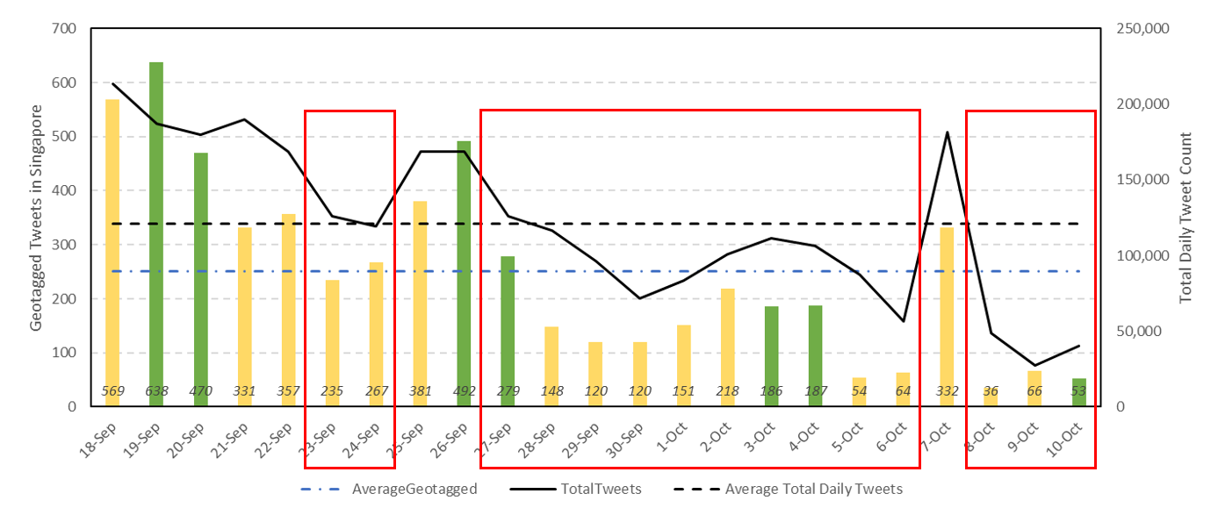
4.2 Spatiotemporal Analysis
Temporal Analysis
Daily total count of tweets in Singapore was highly variable over data collection period
Days with lower than average tweets correspond to days with missing periods of tweet collection
Notes:
Daily total count of tweets and geotagged tweets shows a highly variable pattern over the data collection period. Days with lower than average tweets and geotagged tweets generally correspond with days with missing periods of tweet collection that we had previously mentioned

Slide 23
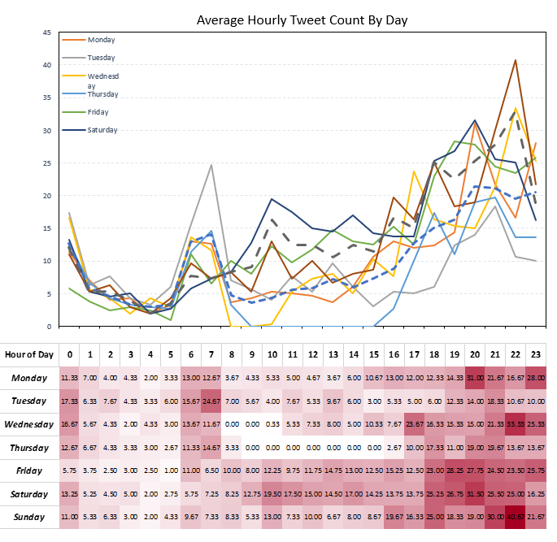
4.2 Spatiotemporal Analysis
Temporal Analysis
Weekdays: 2 peak periods
6-8 AM
After 6PM
Weekends: Gradual increasing tweet activity over course of day
Fewer tweets are posted during office hours (weekday 9AM to 6PM) than other time periods
Notes:
From the graph we can see that there are 2 peak periods for tweet activities on weekdays. This occurs during the morning commuting hours of 6-8am and in the evening after-office hours after 6pm. This could be due to availability of users to engage in online activities. On weekends, the hourly plot shows a smoothly increasing trend for average tweet counts, suggesting that on weekends, online activities grow in intensity gradually over the course of a day, and finally reaching the peak in the late evening. Over the course of a week, fewer tweets are posted during office hours (weekday 9AM - 6PM) than other time periods.

Slide 24
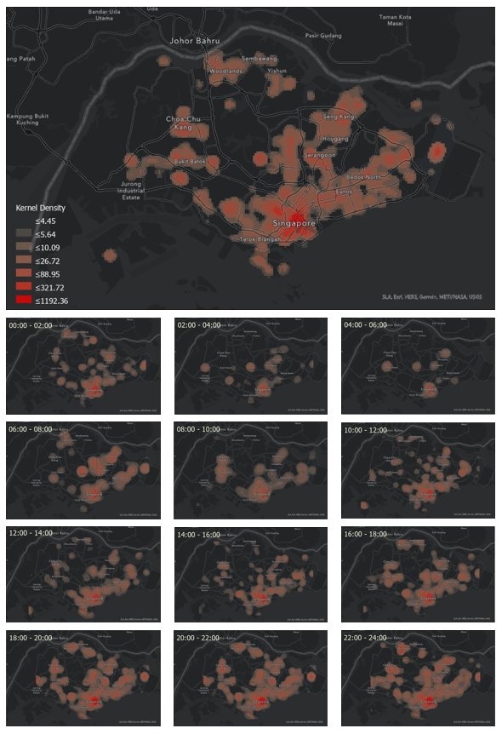
4.2 Spatiotemporal Analysis
Kernel Density of tweet point features show areas with higher density of tweets (CBD, large residential estates and regional hubs)
Incremental Spatial Autocorrelation shows peak distance at around 1km, but low z-score suggest clustering is not statistically significant
Suggests that processes that promote global spatial clustering could be random
Notes:
Results from Incremental Spatial Autocorrelation in ArcGIS on our geotagged tweets show that the peak distance at around 1km but a low z-score suggests that such clustering is not statistically significant. The kernel Density map show some areas with visually higher density of tweets, such as the CBD, and several large residential estates and regional hubs

Slide 25
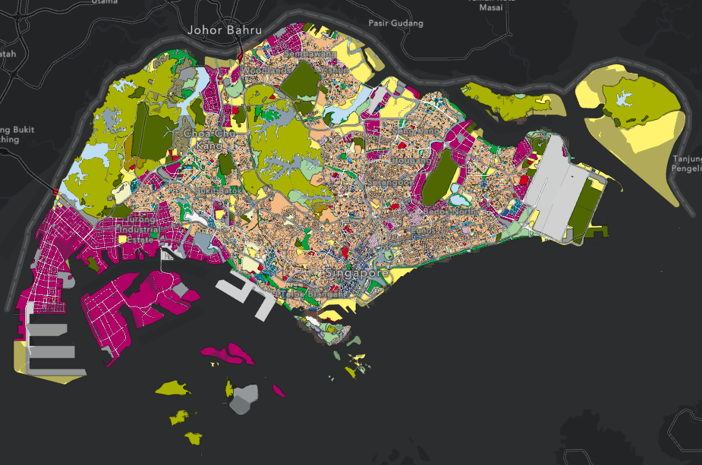
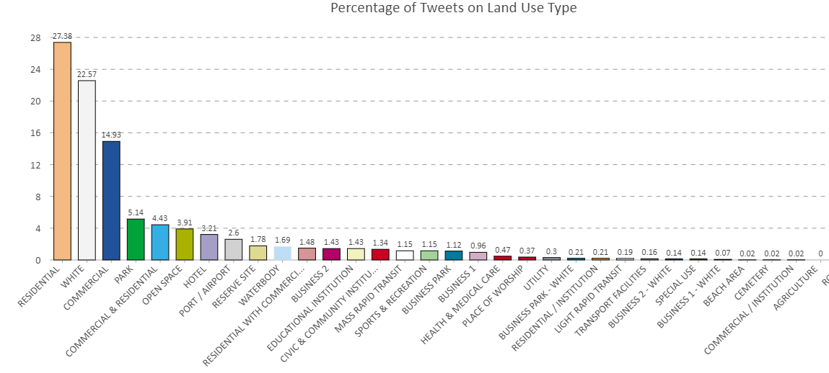
4.2 Spatiotemporal Analysis
Most tweets were posted on Residential land use (27%), followed by White and Commercial land use
Notes:
We also summed up the tweet count based on the land use types from Singapore’s Master Plan they fall on, and found that over 27% of tweets were posted on a Residential land plots, followed by White and Commercial land use types. This is possibly because the work-from-home was still the default mode of working for most businesses and organisations during the data collection period.

Slide 26
4.2 Spatiotemporal Analysis
Segmenting tweets into 2-hour intervals,
Central area presents higher density of tweets across all time periods
4AM to 6AM time period has the lowest spatial coverage of tweet activities, forming islands of tweet density at CBD and large residential estates
Night time tweets cover bigger and contiguous geographical area
Conclude:
Tweeting patterns exhibit distinct diurnal and weekly trends
Visually distinct areas with higher density do not form statistically significant clusters suggests that high density areas are random
Notes:
Tweets were further segmented into 2-hour intervals and Incremental Spatial Autocorrelation was conducted on each time block. For all time blocks, the result shows no statistically significant spatial clusters which suggests that the processes that promote global spatial clustering could be random.
The central area presents a higher density of tweets compared to the rest of singapore for all time periods. The observation was in line with another Twitter study conducted in Singapore in 2012. This can be possibly explained by a greater diversity of land use mix and more important services in the central area. These may attract people there for both work and leisure.
The 4am to 6am (top right hand corner) has the lowest spatial coverage of tweet activities and you can identify distinct islands of tweet density at the CBD and the bigger residential estates. Night time tweets in general cover larger and more continuous geographical area, suggesting more distributed patterns of tweeting activities in off-work hours.
In conclusion, we can observed that tweeting patterns exhibit distinct diurnal and weekly trends. Although visually we can identify distinct areas with higher density, these areas do not form statistically significant spatial clusters, suggesting that random processes could have contributed to the formation of such high density areas in post-CB Singapore.

Slide 27
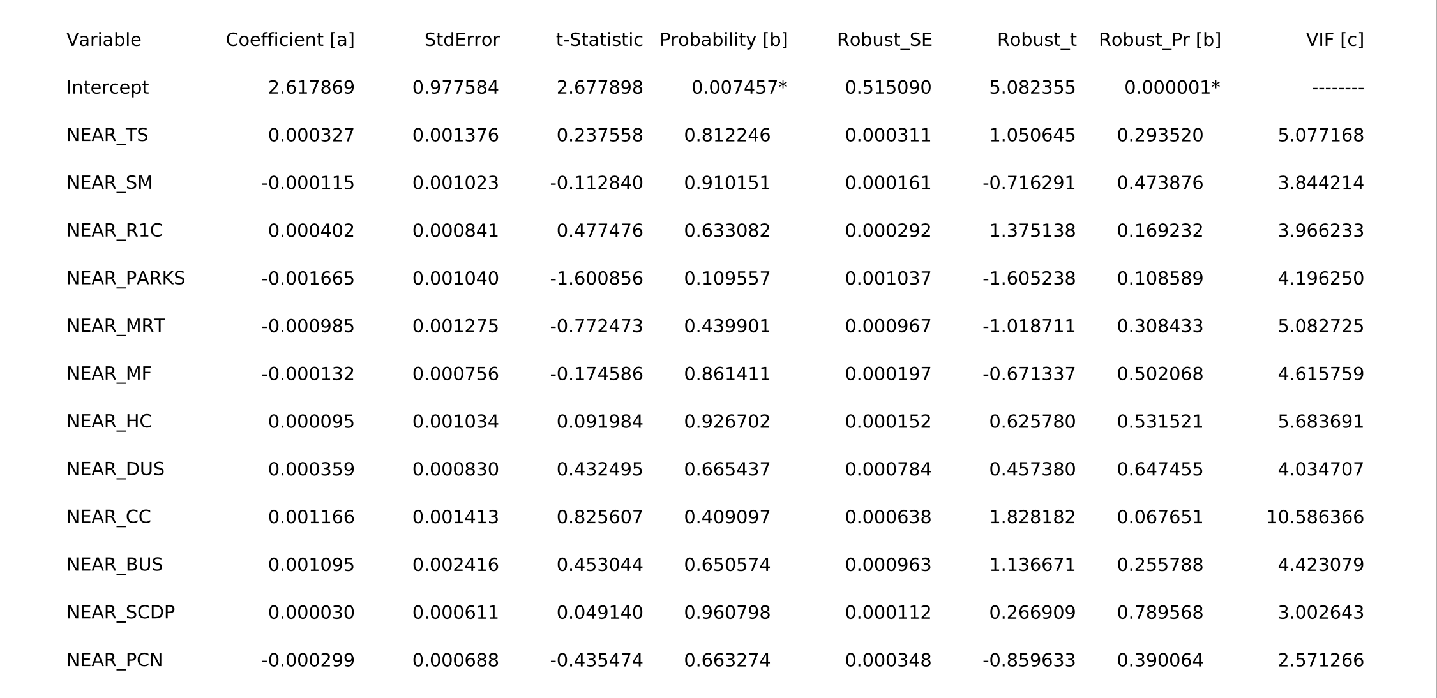
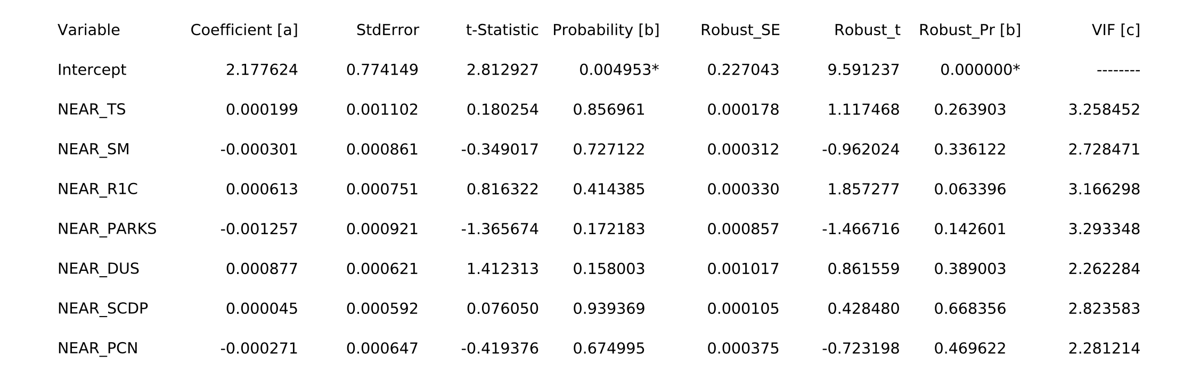
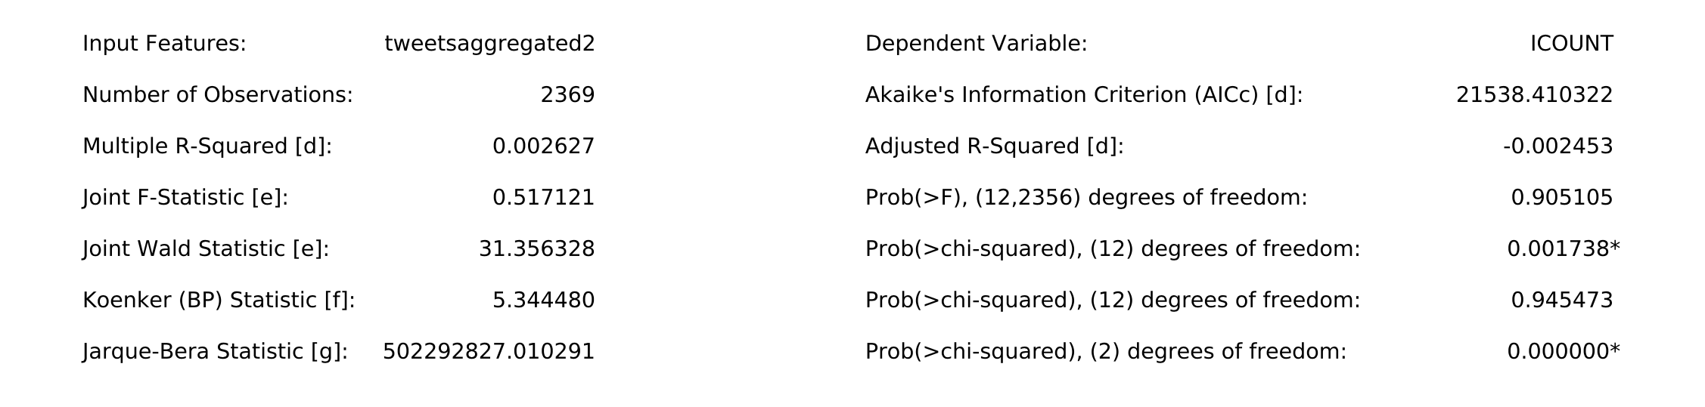
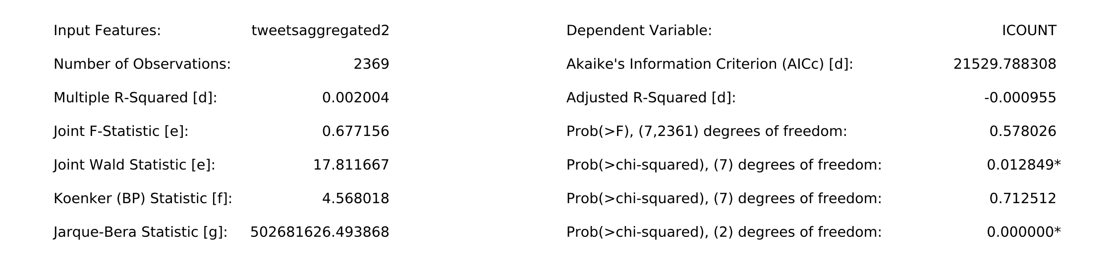
4.3 Ordinary Least Squares (OLS) Regression Analysis
5 out of 12 explanatory variables were removed for reflecting a high VIF value or high correlation R-Squared value. Resulting final model has a lower VIF value for remaining variables and significance of the Koenker (BP) statistics has increased.
Notes:
Of the 12 explanatory variables in the OLS regression, distance to community centres was removed for reflecting a high VIF (Variance Inflation Factors) value, while MRT, hawker centres, busstops and medical facilities were removed for high correlation r-squared value. So for the final model we used 7 variables (the ones on the right), and results show that it is an improvement from the first model, as the VIF values for the remaining variables are lower, and are therefore suitable explanatory variables. The significance of the Koenker statistics has also increased.
-next slide-
Despite showing improved variable suitability, the final model remained weak in performance,because of the low Multiple R-Squared and Adjusted R-Squared value
This suggests that the model is able to account for a very low percentage of dependent variables. This could be because the model is missing key explanatory variables or that a linear regression may not be a suitable model choice. The low coefficient values for all explanatory variables suggest that the relationships between them and the dependent variable are weakly positive or negative. It should also be noted that none of the explanatory variables are associated with a statistically significant coefficient, and a significant probability of Jarque-Bera Statistic suggests that the model is highly biased.

Slide 28
4.3 Ordinary Least Squares (OLS) Regression Analysis
Influence of 7 remaining variables:
Ranking | Variable | Coefficient (Absolute)
1 | Park (NEAR_PARKS) | 0.001257
2 | Dual Use Scheme (NEAR_DUS) | 0.000877
3 | Residential with 1st Storey Commercial (NEAR_R1C) | 0.000613
4 | Shopping Mall (NEAR_SM) | 0.000301
5 | Park Connector Network (NEAR_PCN) | 0.000271
6 | Taxi Stand (NEAR_TS) | 0.000199
7 | SCDP Park Malls Public Link (NEAR_SCDP) | 0.000045
Notes:
Taking the absolute number from the coefficients, we have ranked the influence of the 7 remaining variables.

Slide 29
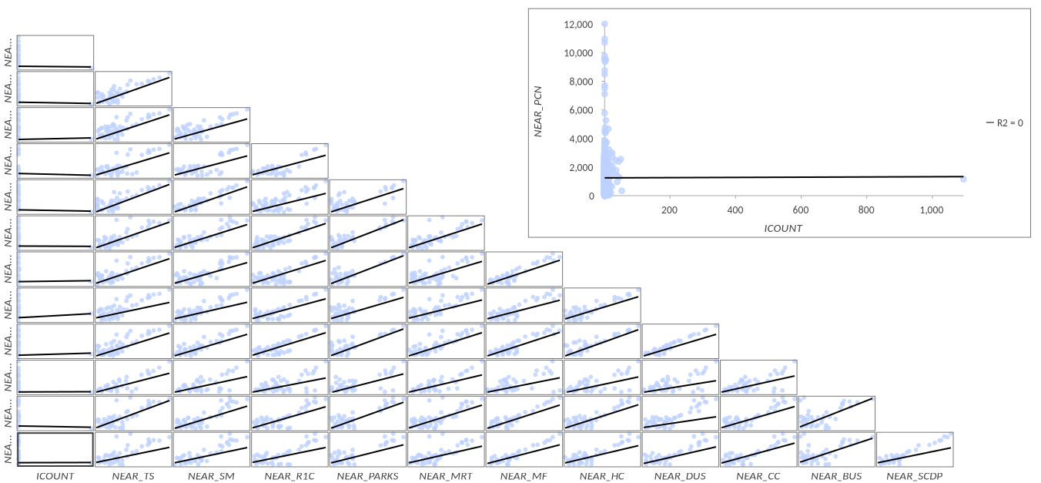
4.3 Ordinary Least Squares (OLS) Regression Analysis
The residues deviate from the line of best fit and therefore is not normally distributed.
The skewness (normally distributed = 0 vs. dataset = 47) and kurtosis (normally distributed = 3 vs. dataset = 2266) values are also far from a typical normally distributed dataset.
Non- parametric tests that are free from underlying assumptions of dataset distribution could be more suitable for this study
Notes:
From this figure, we observe that the residues deviate from the line of the best fit and are thus not normally distributed. This is against the classical assumptions of OLS, giving us estimates that are biased with high variances. Additionally, the skewness and kurtosis values are far from that of a typical normally distributed dataset.
Perhaps a non-parametric tests that are free from any underlying assumptions of the dataset distribution could be more suitable for this particular studies. Alternatively, a log-linear scale in the model may improve the estimates and their significance as well.

Slide 30
4.4 Random Forest Regression and Modelling
Summary of Regression Diagnostics
R-squared value of validation data suggests that model is able to explain 50.7% of observed variation; small p-value (<0.025) shows that it is statistically significant
Indicates that model may still lack key explanatory variables which will improve the performance of the model
Uncertainty in input data due to the nature of Volunteered Geographic Information data will also affect performance and accuracy of model
 | Training Data | Validation Data
R-Square | 0.868 | 0.507
P-Value | 0.000 | 0.000
Standard Error | 0.005 | 0.086
Notes:
For the random forest model, the r-squared value of the regression diagnostics suggest that the model is able explain 50.7% of the observed variation, and is statistically significant with a pvalue of less than 0.025. This suggests that the model may still be lacking key explanatory variables which will improve the performance of the model. The uncertainty in the input data due to the nature of Volunteered Geographic Information (VGI) data also affects the performance and accuracy of the random forest model.

Slide 31
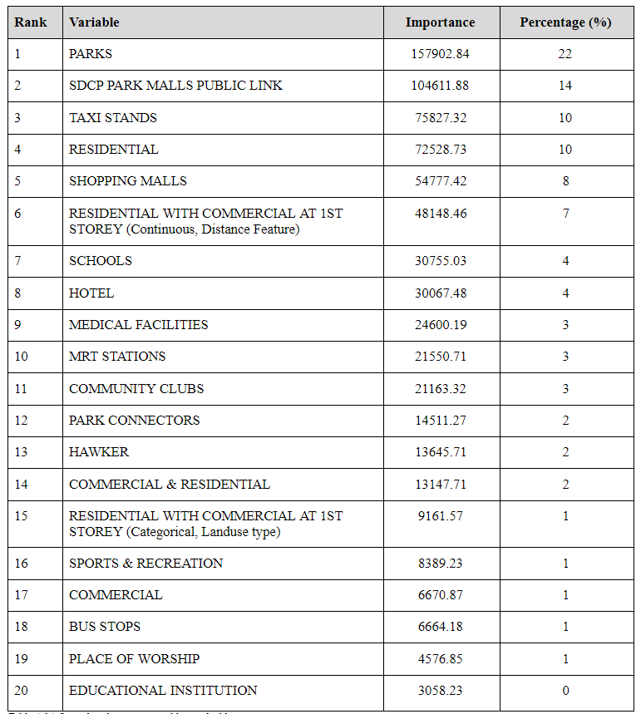
4.4 Random Forest Regression and Modelling
Top 20 variables ranked according to importance in driving results of the random forest model
Top 5 variables make up more than half of variable importance
Notes:
These are the top 20 variables based on the model. We’ve ranked them according to their importance in driving the results of the random forest model the top 5 variables make up more than half of the variable importance, indicating that they are highly influential in training the random forest model

Slide 32
5.0 Discussion

Slide 33
5.1 Spatiotemporal Tweet Patterns and Contribution from Service Amenities
Distinct diurnal and weekly activity patterns that closely resemble typical office work temporal profile
No statistically significant spatial cluster
Activity patterns post-CB could not be adequately explained by distance to service amenities
OLS Regression using distances to service amenity POIs as explanatory variables
Results suggest poor model accuracy and absence of significant variable
Distance to service amenities not strong explanatory factor for activity patterns
Random Forest Model
Improved model performance
identified amenities and land use type that were more important explanatory variables for activity patterns
Residential land was included in random forest method but not OLS regression. With high percentage of tweets coming from residential land probably due to work-from-home arrangements
Notes:
So looking at the tweet activity patterns, we observed firstly that distinct diurnal and weekly activity patterns that closely resembles a typical office work temporal profile. Meaning more activities occur outside office hours. During the weekend, activity increases gradually over the day, rather than showing distinct peak activity periods. This also shows that the majority of Twitter users in Singapore could be engaged with typical working-hour schedules, and tend to post more tweets outside of office hours.
Secondly, even though there are areas with visually higher tweet activity, there is no statistically significant spatial cluster. The processes that contribute to the observed varied spatial activity density could be a result of random processes, and further segmentation is required to uncover the mechanism of such processes and their influence on activity patterns.
Third, Activity patterns in post-CB Singapore could not be adequately explained by distance to service amenities. We performed the OLS regression with the assumption that service amenities could attract human activities, but the result suggests poor model accuracy and absence of significant variable coefficients. This means that distances to service amenities are not strong explanatory factors for activity patterns in post-CB Singapore.
The Random Forest Model showed improved model performance by focusing on activities in recreational hours and also accounting for land use mix. The result suggests that several amenities and land use types, such as parks, shopping malls, residential developments and HDB shop houses are among the more important explanatory variables for activity patterns post-CB.
It should be noted that residential land is also the top land use type where tweet activities are found, but this was not included in the OLS regression model, which could have contributed to the poor OLS regression model performance. The high percentage of tweets from residential land and its relatively strong explanatory factor might be explained by the fact that work-from-home is still the default mode of working during the data collection period. Therefore, locations of residential land might have accounted for a majority of tweet activities post-CB.

Slide 34
5.2 Suitability of Twitter Data for Geospatial Research on Singapore
Twitter data rarely used to study activity patterns in Singapore
Twitter user group is a biased representation of the Singapore resident population
Small number of users as compared to population
Uneven representation: might be more representative of young adults
Among Twitter users, each user is unevenly represented: majority posted 1 tweet over the data collection period
Inconsistent quality of spatial attributes
Data quality influenced by Tweeting habits
Relies on voluntarily posted tweets
Limitations with free-of-charge public API
Amount of tweets collected will not exceed 1% of all tweets posted by users
⇒ Consider using chargeable Premium API to access the full Twitter dataset
⇒ Scope targeted research questions that can be adequately answered with Twitter data
Notes:
Next we would like to discuss about the suitability of twitter data for geospatial research. Prior to our study, Twitter data was rarely used to study activity patterns in Singapore and there was no evaluation of suitability of Twitter data to study urban place related issues.
From our study, we understand that Twitter user group is a highly BIASED representation of the Singapore population. Only a small number of users, as compared to the resident population, posted tweets that can be geotagged to a precise location in Singapore. Due to absence of other user details, such as age, race and gender, we are unable to analyse if the Twitter user group constitutes a representative sample of the resident population. According to Statista, it estimated that twitter users in Singapore are mostly aged between 25 and 34. This suggests that the tweets collected only represent a small group of young working adults, which might explain why the temporal patterns that we observed closely resemble a typical office work patterns.
Among the Twitter users, each user is unevenly represented, with the majority of users only posting 1 tweet over the whole period of data collection, while a small handful of active users contributes to the large majority geotagged tweets.
Next, there is also the issue of inconsistent quality of spatial attributes. Only 0.28% of all tweets were geotagged to a precise XY coordinate, and another 0.31% geotagged to a specific landmark. Over 96% of tweets do not have any discernible location attribute.
Tweeting habits may influence data quality as well. The study relies on voluntarily posted tweets to understand temporal and spatial activity patterns. But It is well documented that not all places receive equal coverage on social media, as users may selectively report locations only when they are deemed important to be shared.
We are also limited by the free public twitter API. The amount of tweets collected will not exceed 1% of all tweets posted by users. Twitter does not disclose the mechanism of this 1%. the tweets collected could probably be more representative for users who have posted more, than the infrequent users.
We could have perhaps used a chargeable premium API from Twitter to access the full Twitter dataset.
Many of the above-mentioned weaknesses of Twitter data are characteristic to VGI big data due to absence of quality control on user-generated content. However, Twitter data still represents a valuable dataset that is accessible to the general public, and contains temporal, spatial and semantic attributes that can be further exploited with a suitable research question that adequately addresses data bias and quality issues.

Slide 35
5.3 Other Limitations
Absence of Pre-CB Activity Pattern as a Benchmark
Prevents a comparison of pre- and post-CB activity patterns in order to assess the effectiveness of safe distancing and risk communication measures on physical activity patterns
Missing Time Periods in Data Collection
Limits accurate understanding of temporal tweet patterns
Geocoding
Data collected in Place_Name field often invalid (improper place names, spelling mistakes, etc) -- result in unsuccessful conversion and therefore excluded from geocoding process
Place names with general location (e.g. Central Region) rather than specific location -- results in inaccurate location
Place names that may occur in more than one location (e.g. Fairprice) -- may results in inaccurate location
Notes:
Other limitations that we have identified is the absence of pre-cb activity pattern as a benchmark. As our study focuses on activity patterns in the context of post CB, an understanding of the pre-CB activity patterns and correlations with service amenities will allow a comparison of pre- and post-CB activity patterns, and assess the effectiveness of safe distancing and risk communication measures on physical activity patterns.
Next, as we have mentioned at the start, there were missing blocks of time when tweet collection was unsuccessful. pose challenges for an accurate understanding of temporal tweet patterns. In this study, we had attempted to minimise the impact by segmenting the datasets into time periods for separate analysis. However, a full and complete period of data collection would still be beneficial to present an unbiased study on the activity patterns post-CB.
For geocoding, there are 3 main limitations, 1, data collected in the Place_Name field of the twitter data is not always valid, resulting in an unsuccessful conversion when geocoding.
2. There were many place name with a generation location rather than a specific location and this will lead to inaccurate location
3. Some place names may occur in more than 1 location, restaurants and supermarkets are some examples. Therefore the geocode returned might also not be accurate
So when studying mobility behaviours using the tweets itself, there is a risk of skewed data as inaccurate locations is not easily detected by GIS tools. The accuracy of the geocoding process is only as accurate as the quality of the input data.

Slide 36
6.0 Conclusion

Slide 37
6.0 Conclusion
What we have presented:
An attempt to explore spatiotemporal activity patterns in Singapore after Circuit Breaker using Twitter data
A discussion of how Twitter data may be relevant for geospatial research in Singapore
Preliminary insights to whether service amenities and land uses might impact (or not) spatial activity patterns in post-CB Singapore
Recommendations for further research:
Long-term monitoring of activity patterns to understand behaviour changes, and effectiveness of regulations
Twitter data is still valuable; appropriate research questions can be scoped bearing in mind the inherent limitations of such VGI data
Notes:
In conclusion, our study attempt to explore spatiotemporal activity patterns and model the relationship between activity patterns with service amenities in post-CB Singapore using Twitter data.
The findings offered preliminary insights into place-visiting patterns in Singapore. And We showed that distances to service amenities is not strong explanatory variables for the activity patterns we observed in post-CB Singapore. The random forest model accounting for landuse mix can predict activity patterns in off-work recreational hours with up to 50.7% accuracy. However key explanatory variables could still be missing.
For further research, we believe longer periods of data collection on people movement will enable an understanding of how place-visiting behaviours respond to the changing regulations. And although Twitter data may have their limitations the research questions can be narrowed down further so that it can be adequately and accurately answered with such data.

Slide 38
7.0 References

Slide 39
7.0 References
Bruns, A. and Stieglitz, S. (2012). Quantitative Approaches to Comparing Communication Patterns on Twitter. Journal of Technology in Human Services, 30(3-4), 160-185.
Davie, S. (2020). NUS plans to keep students within zones on campus. The Straits Times, 24 May 2020. Accessed 20 October 2020 from https://www.straitstimes.com/singapore/education/nus-plans-to-keep-students-within-zones-on-campus.
Gov.sg (3 April 2020). PM Lee: The COVID-19 Situation in Singapore (3 Apr). Accessed 9 Sept 2020 on https://www.gov.sg/article/pm-lee-hsien-loong-on-the-covid-19-situation-in-singapore-3-apr.
Gov.sg (28 May 2020). Ending circuit breaker: phased approach to resuming activities safely. Accessed 31 Oct 2020 from https://www.gov.sg/article/ending-circuit-breaker-phased-approach-to-resuming-activities-safely.
Gov.sg (20 Oct 2020). Roadmap to Phase 3. Accessed on 31 Oct 2020 from https://www.gov.sg/article/roadmap-to-phase-3.
Graham, M., Hale, S.A. and Gaffney, D. (2014). Where in the World Are You? Geolocation and Language Identification in Twitter. The Professional Geographer, 66(4), 568-578.
Hecht, B., Hong, L., Suh, B. and Chi, E.H. (2011). Tweets from Justin Bieber’s Heart: The Dynamics of the “Location” Field in User Profiles. CHI ‘11: Proceedings of the SIGCHI Conference on Human Factors in Computing Systems, 237-246.
Kabir, M.Y. and Madria, S. (2020). CoronaVIS: A Real-time COVID-19 Tweets Data Analyzer and Data Repository.
Kang, C., Sobolevsky, S., Liu, Y. and Ratti, C. (2013). Human Movements in Singapore: A Comparative Analysis Based on Mobile Phone and Taxicab Usages. UrbComp ‘13: Proceedings of the 2nd ACM SIGKDD International Workshop on Urban Computing, 1-8.
Kovacs-Gyori, A., Ristea, A., Kolcsar, R., Resch, B., Crivellari, A., and Blaschke, T. (2018). Beyond Spatial Proximity - Classifying Parks and Their Visitors in London Based on Spatiotemporal and Sentiment Analysis of Twitter Data.International Journal of Geo-Information, 2018, 7, 378.
Lai, J., Lansley, G., Haworth, J., Cheng, T. (2019). A name-led approach to profile urban places based on geotagged Twitter data. Transactions in GIS, 2020 (24), 858-879.
Lee, R. and Sumiya, K. (2010). Measuring Geographical Regularities of Crowd Behaviors for Twitter-based Geo-social Event Detection. In Proceedings of the 2nd ACM SIGSPATIAL International Workshop on Location Based Social Networks (LBSN '10). Association for Computing Machinery, New York, NY, USA, 1–10. DOI:https://doi-org.libproxy1.nus.edu.sg/10.1145/1867699.1867701.
Liu, X. and Long, Y. (2016). Automated identification and characterisation of parcels with OpenStreetMaps and points of interest. Environment and Planning B: Planning and Design, 43(2), 341-360.
Marti, P., Serrano-Estrada, L, Nolasco-Cirugeda, A. (2017). Using locative social media and urban cartographies to identify and locate successful urban plazas. Cities, 64 (2017), 66-78.
Prasetyo, P.K., Achanauparp, P. and Lim, E. (2016). On Analysing Geotagged Tweets for Location-Based Patterns. ICDCN’ 16: Proceedings of the 17th International Conference on Distributed Computing and Networking, 45, 1-6.
Rao, K. V., Govardhan, A., and Rao, K. V. C. (2012) .Spatiotemporal Data Mining: Issues, Tasks and Applications. International Journal of Computer Science and Engineering Survey, 3(1), 39 – 52.
Resch, B., Uslander, F., Havas, C. (2018). Combining machine-learning topic models and spatiotemporal analysis of social media data for disaster footprint and damage assessment. Cartography and Geographic Information Science, 2018 (45), 4, 362-376.
Sloan, L. and Morgan, J. (2015). Who Tweets with Their Location? Understanding the Relationship between Demographic Characteristics and the Use of Geoservices and Geotagging on Twitter. PLoS ONE, 10(11).
Soliman, A., Soltani, K., Yin, J., Padmanabhan, A. and Wang, S. (2017). Social sensing of urban land use based on analysis of Twitter users’ mobility patterns. PLoS ONE, 12(7).
Statista (n.d.). Number of Twitter users in Singapore in 2019 and 2020 (in millions)*. Accessed 31 Oct 2020 from https://www.statista.com/statistics/490600/twitter-users-singapore/.
Toh, T. W. (26 April 2020). Food delivery sector booms in a time of coronavirus. The Straits Times. Accessed on 31 Oct 2020 from https://www.straitstimes.com/singapore/transport/sector-booms-in-a-time-of-coronavirus.
Wei, Y., and Lan, M. (2015). GIS analysis of depression among Twitter users. Applied Geography, 60 (2015), 217-223.
Yan, Y., Feng, C-C., Huang, W., Fan, H., Wang, Y-C and Zipf, A. (2020). Volunteered geographic information research in the first decade: a narrative review of selected journal articles in GIScience. International Journal of Geographical Information Science.
Zhan, X., Ukkusuri, S.V. and Zhu, F. (2014). Inferring Urban Land Use Using Large-Scale Social Media Check-in Data. Networks and Spatial Economics, 14, 647-667.

